Slide 1
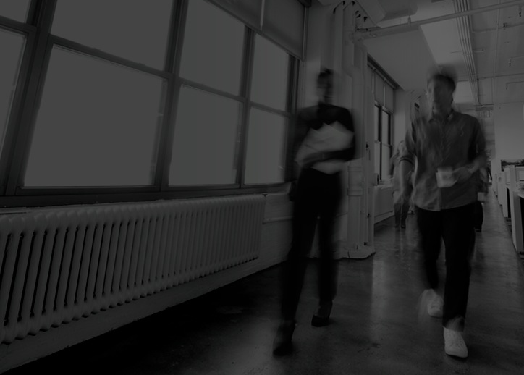

THE-Collaboratory green mountain coffee beauty, health, wellness

Slide 2
what are beauty, health & wellness?

Slide 3
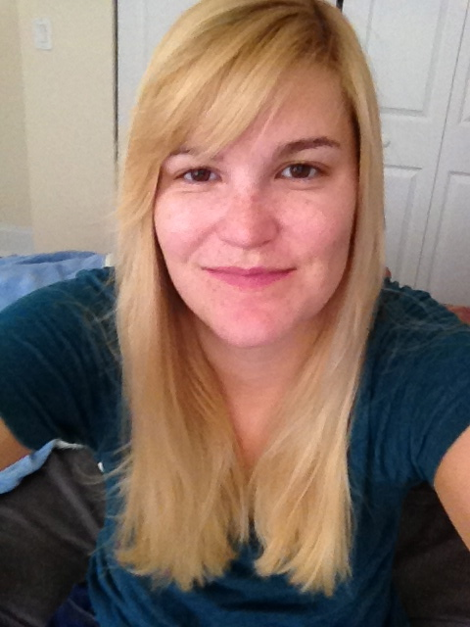
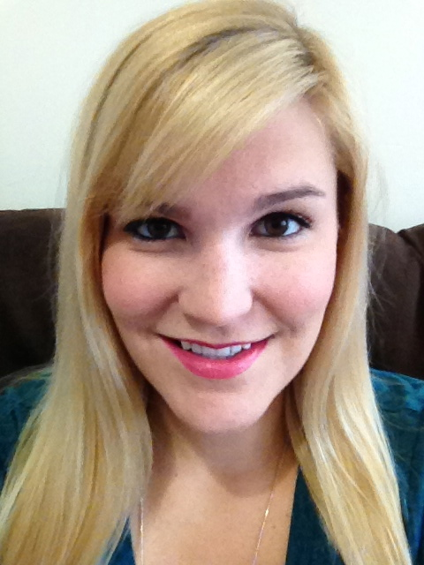


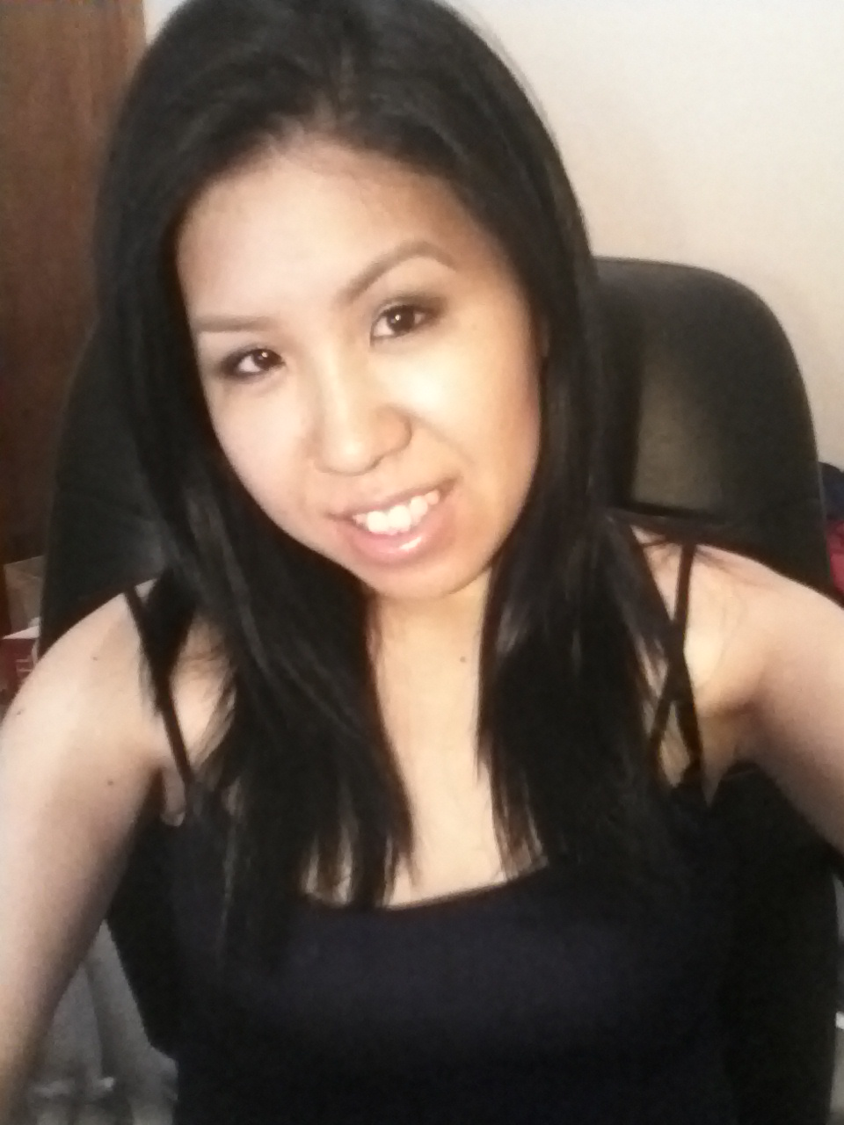
BEAUTY is…
an aspirational outward appearance
something that can be improved with proper care and attention
confidence and feeling good about yourself
one of the factors that affects how society treats you
beauty to me refers to how great you look. It is something that attracts people to yourself
when I feel beautiful, I immediately feel more confident and powerful ….beauty is something I have control over
beauty would include all of the things you do to make yourself more attractive/sexy/desirable

Slide 4
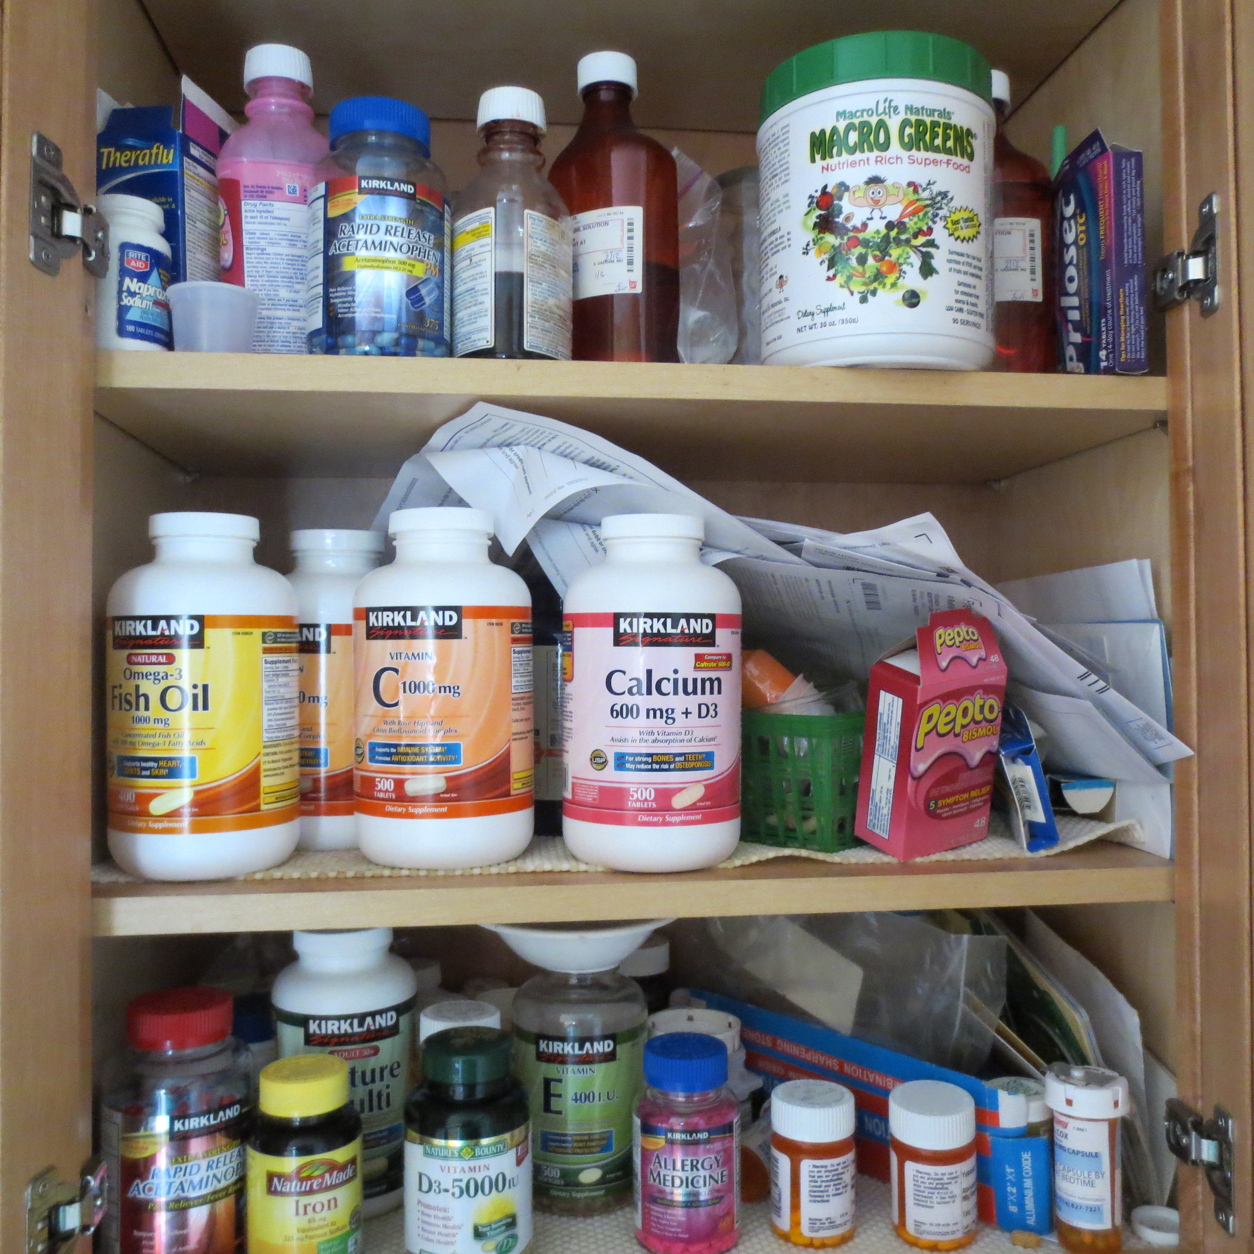
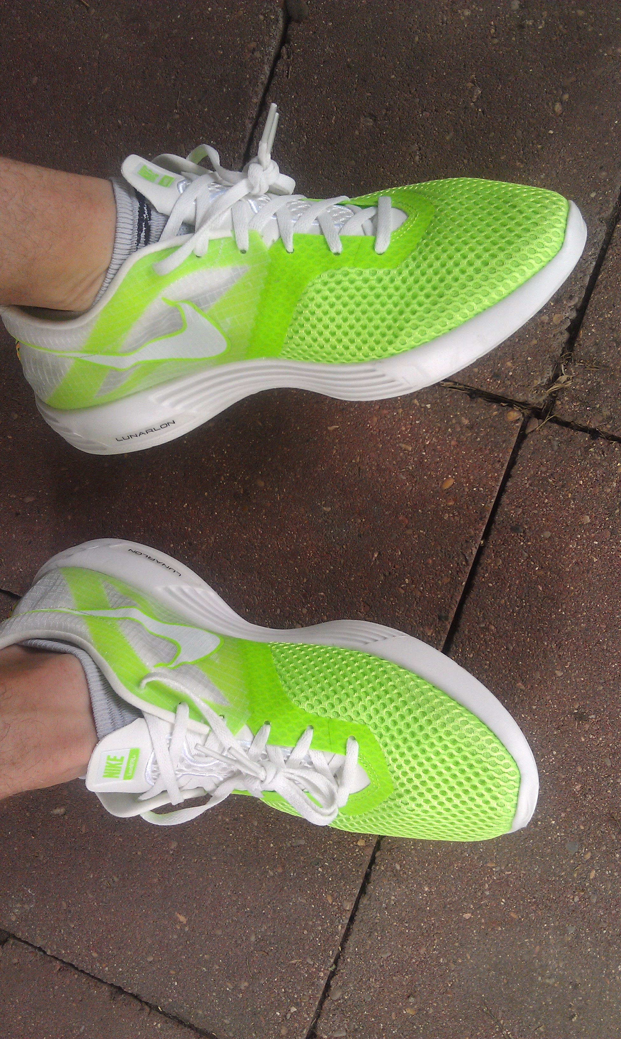
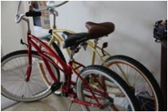
health is…
physical condition of the body
what you do to:
prolong your life
feel good
prevent illness
often driven by a desire for beauty
health is…exercise, eating right, taking care of yourself and long term war on your body”
I am an avid runner. I love running. It makes me feel better both mentally and physically. It is a great way to relieve stress
health is freedom from pain, illness and physical barriers…”

Slide 5
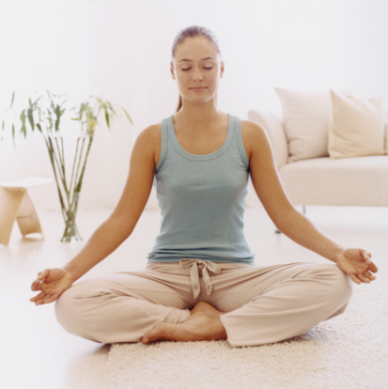
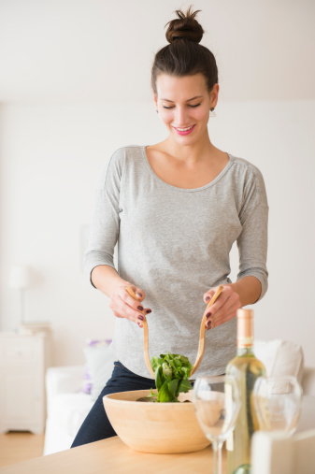
wellness is…
a state of being in balance; being healthy in the physical body, mind and soul; a state of well being”
a more elevated quality of life
the positive connection between mental and physical states
A holistic approach to health
the ultimate goal of a health and beauty routine
…quote
wellness is a combination of health and beauty that determine your quality of life
wellness combines physical and mental health as well as beauty, and defines the entirety of how you feel

Slide 6
beauty, health, wellness
inputs:
substances or procedures that alter one’s appearance (e.g. cosmetics, hair styling, etc.)
outcome:
both emotional and physical components
higher confidence level
affects how others treat you
health is a gateway
to beauty
wellness is inner beauty
B
H
W
inputs:
vary depending on definition
seen as intangible quality of life attained by way of health and beauty
sometimes sought through meditation, yoga, relaxation
outcome:
better outlook/quality of life
inputs:
exercise, diet, vitamins, supplements
outcome:
improved physical condition
better appearance
taking care of physical and mental health leads to wellness
your best self

Slide 7
understanding the universal beauty routine

Slide 8
routines are means to an end
for most routines are not an enjoyable activity
morning routines can feel like a chore, especially when time is short
during the process I felt somewhat bored and wished I had a professional makeup artist to fix me up so I didn’t have to bother with it
I just felt like I was doing a routine. I didn't feel particularly good or bad about it, just on autopilot.

Slide 9
…but they are transformational
routines alter how consumers feel
consumers report a change from feeling tired and groggy to ready to face the day
daily routines as well as more special treatments (salon visits, etc.) increase consumers’ confidence levels
I always feel much better after getting myself ‘put together’ – I feel that when I look my best that people talk to me differently
I do feel refreshed after the process is complete with a more energy. Also, I'm usually satisfied w/ my appearance and how I will present myself to the world (look and smell)

Slide 10
majority of routines are beauty–driven
daily routines are driven by beauty
many health routines are motivated by beauty
while morning routines are more driven by beauty, evening routines are more driven by wellness
note: this insight comes from the way people consider health to be so important, but spoke more about beauty when it came to daily routine

Slide 11
when it comes to routines, time is a luxury
if consumers had more time, they would indulge more in routines
more time for routine makes it more enjoyable experience
I really enjoy the rush to see how fast I can get looking my best…If I would get up earlier; I think I could put a little more effort into everything

Slide 12
THE UNIVERSAL ROUTINE
refresh
“face” the day
remove & relax
internal health
special treat
shower
wash face
brush teeth
moisturize
apply makeup
style hair
dress
odor control
remove makeup
wash face
change clothes
shower (for some)
exercise
vitamins
other health measures
salon visits
facial care
hair removal
steps
refresh is a transformation from tired and uninspired to fresh and ready to start the day
appearances is preparing yourself to walk out the door and greet the world
remove and relax is washing off the day and decompressing until it’s time for bed
internal health is about keeping your insides clean and efficient and helping fight off illness and disease
occasional is those special treats to keep things working smoothly
insights
5:00 PM
8:00 PM
8:30 PM
9:15 PM
from the consumer
“The shower is refreshing it is invigorating and makes my whole body feel refreshed”
“I like to do my makeup, it’s a nice 10 minute ritual in the morning where I can collect my thoughts and plan my day. ”
“I feel so much better when I get my makeup all off, like my face is 10 pounds lighter and I can finally touch my eyes”
“I love running. It makes me feel better both mentally and physically. It is a great way to relieve stress”
“Getting my hair washed by someone else feels completely different from doing it at home…I just feel so pampered.”
W
B
W
W
H
W
H,B,W
B
H
W
B
H

Slide 13
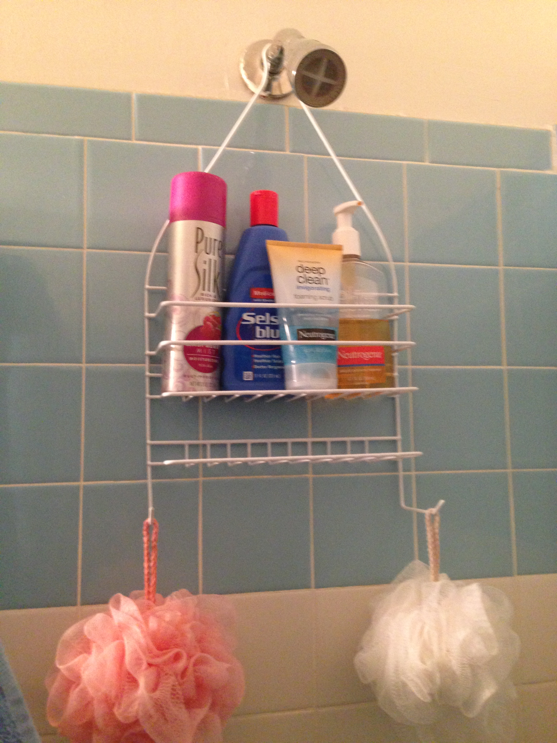
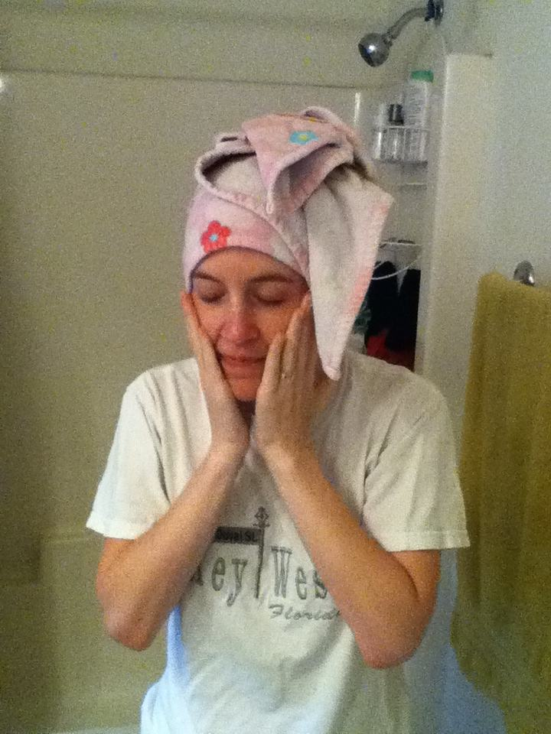
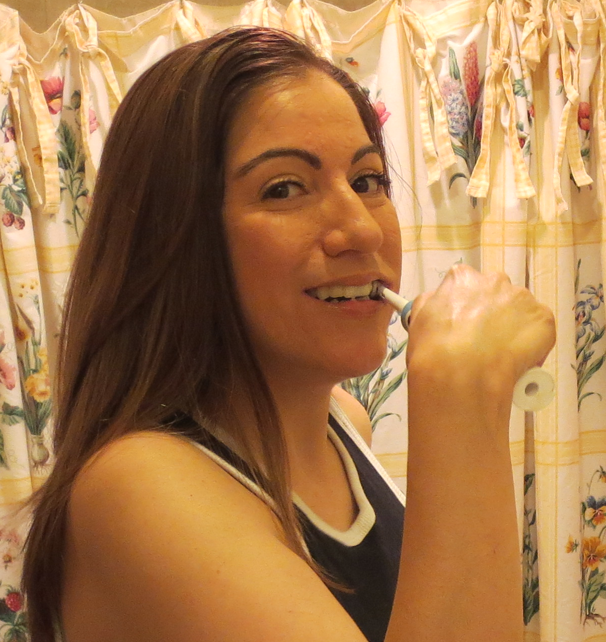
THE UNIVERSAL ROUTINE: refresh
SHOWER
clean body
shampoo hair
condition hair
shave (women)
towel dry hair
2. WASH FACE
apply cleanser
rinse off with water
apply toner
moisturize
sometimes exfoliate
apply SPF
3. BRUSH TEETH
floss
brush teeth
rinse with water
rinse with mouthwash
8:00 PM
examples of products
NEXXUS HYDRA-LIGHT SHAMPOO
CETAPHIL GENTLE SKIN CLEANSER
TRESEMÈ HYDRATING CONDITIONER
OLD SPICE PURE SPORT BODY WASH
VARIATIONS
some wash hair at night
doubles as a night time routine
examples of products
CETAPHIL DAILY FACIAL CLEANSER
OXY MAXIMUM FACE WASH
NEUTROGENA DEEP CLEAN EXFOLIATING SCRUB
VARIATIONS
Some wash face at the end of the day
Some moisturize after, some don’t
examples of products
CREST PRO-HEALTH WHITENING TOOTHPASTE
ORAL-B PRO-HEALTH DENTAL FLOSS
LISTERINE ANTISEPTIC MOUTHWASH
PHILIPS SONICARE TOOTHBRUSH
VARIATIONS
Some brush before breakfast, some wait until after
Some use mouthwash in the mornings too
Most floss at night
8:30 PM

Slide 14
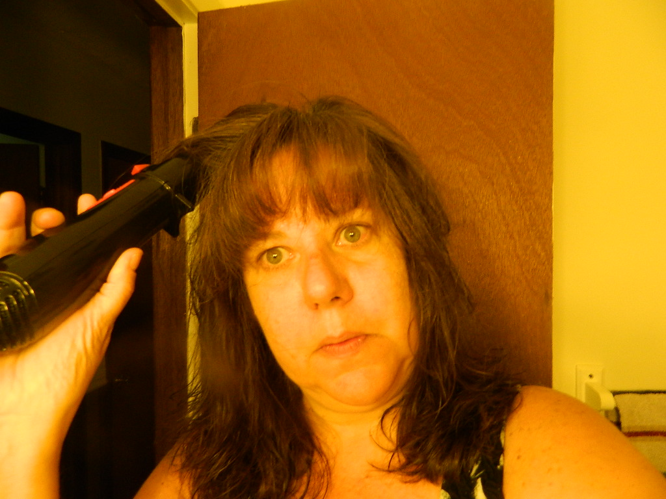
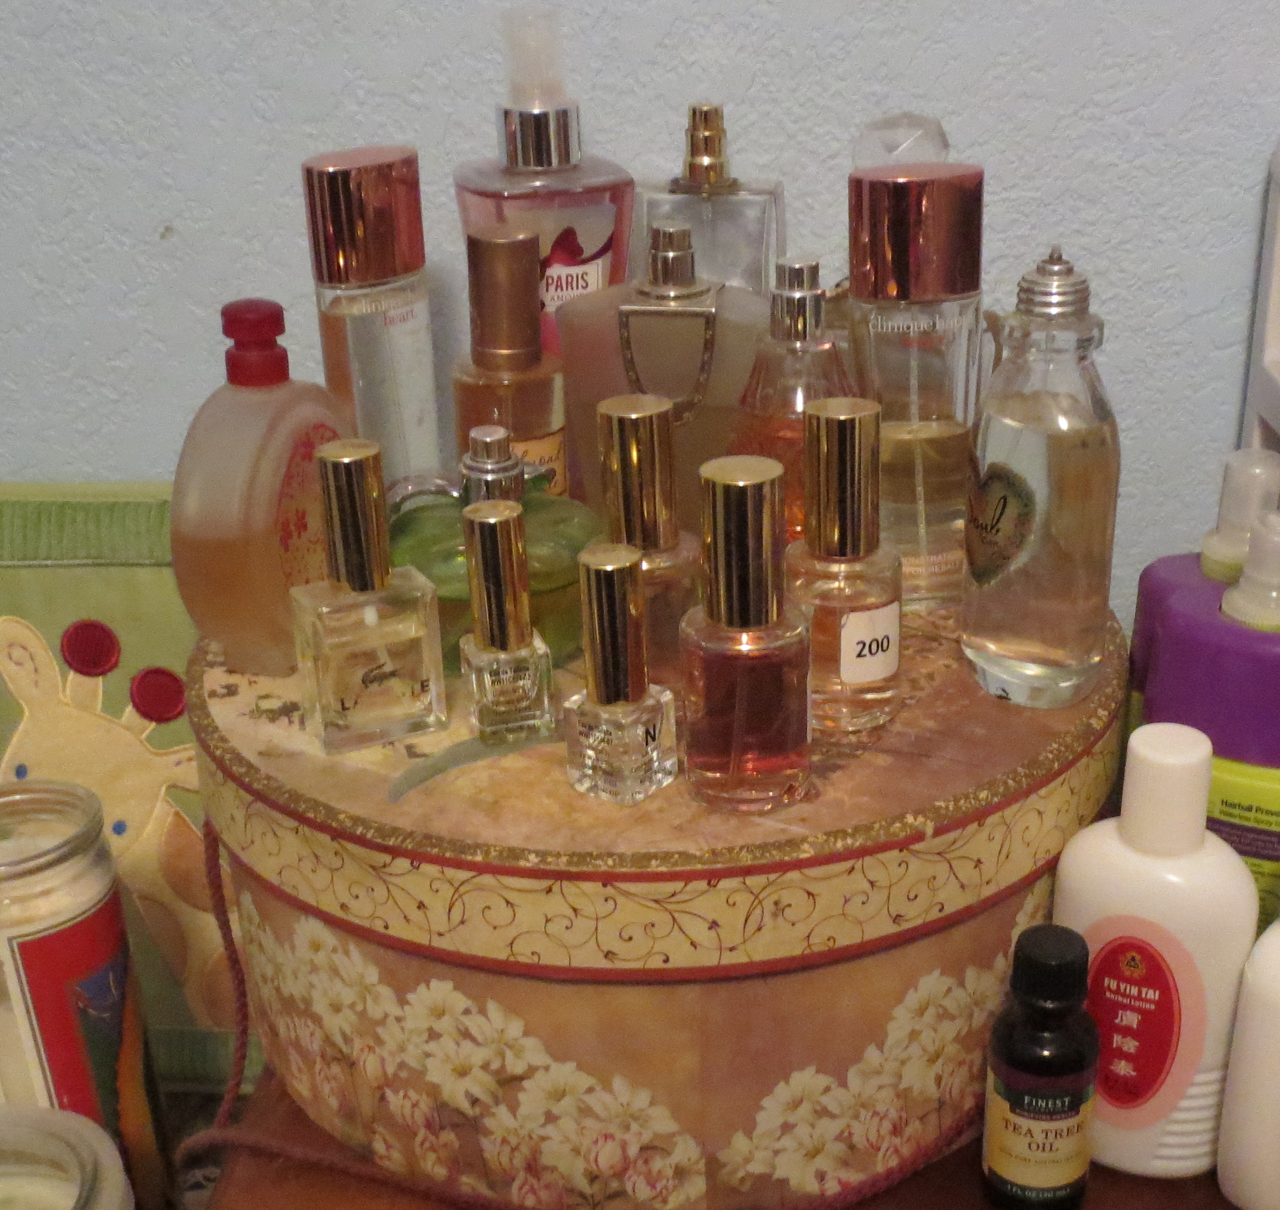
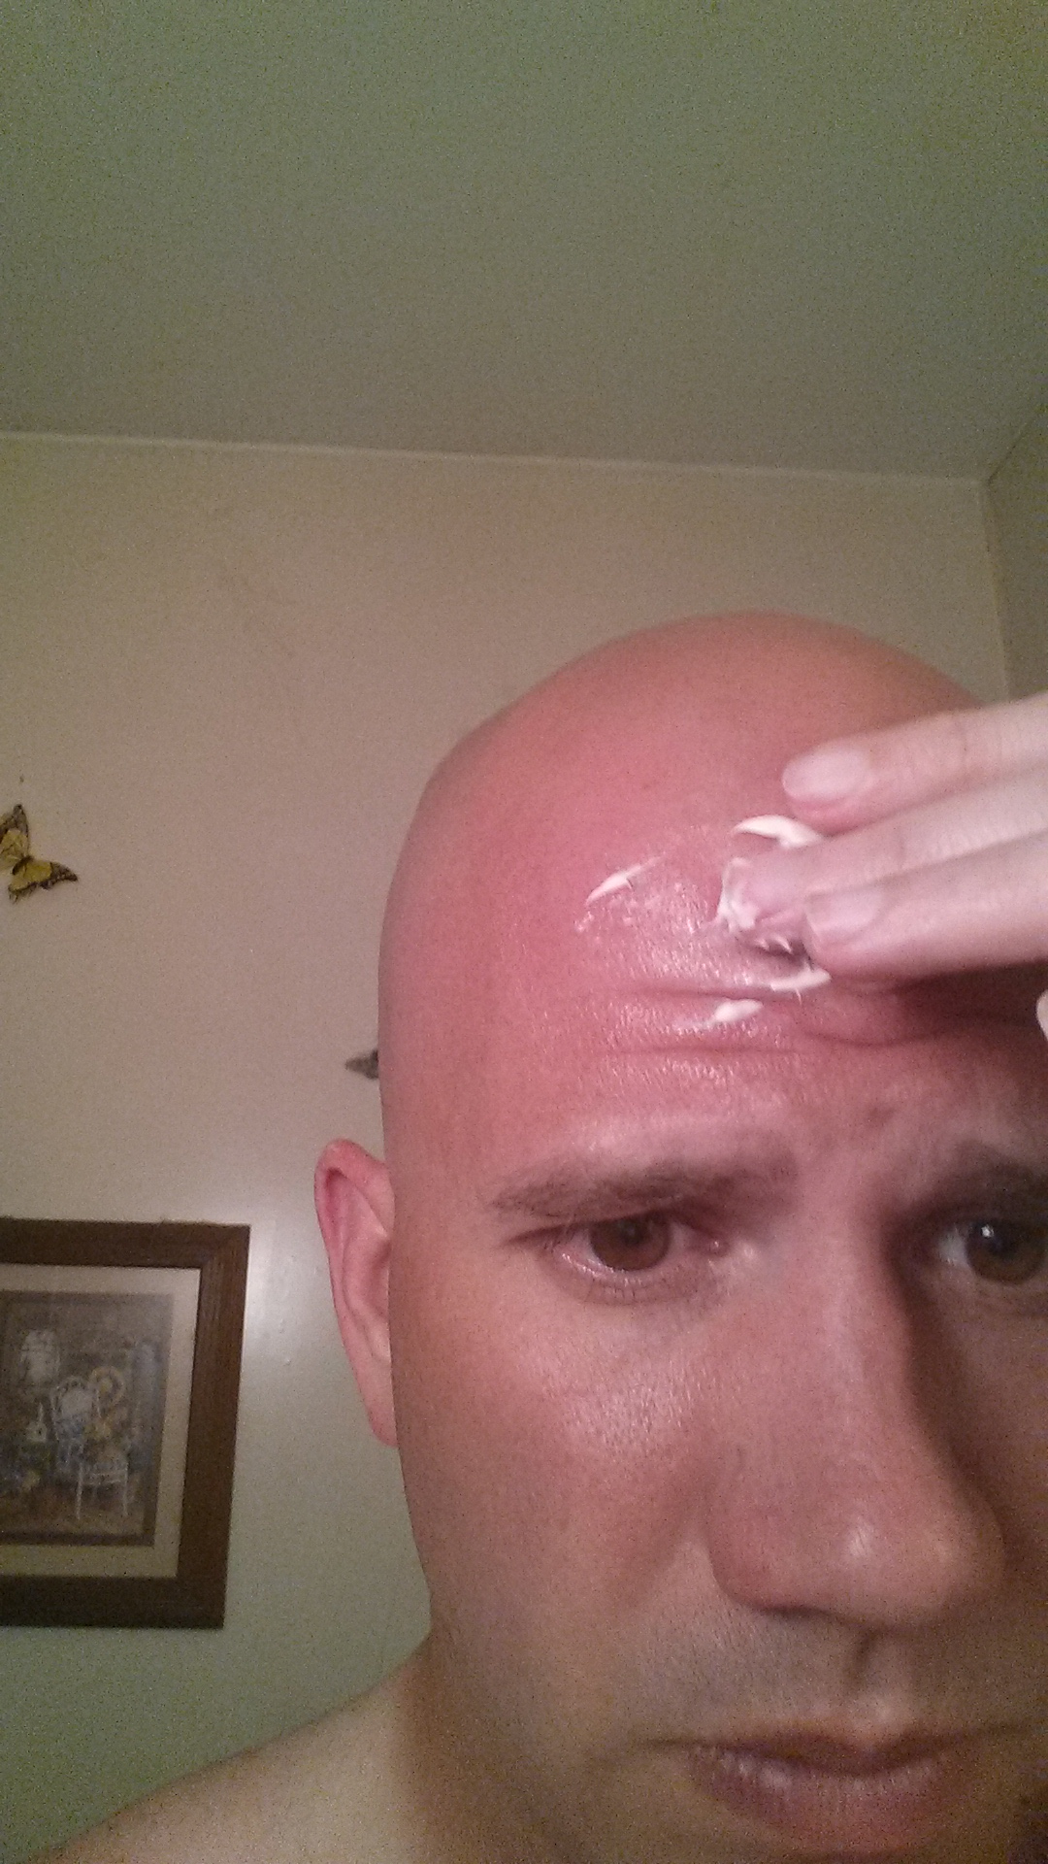
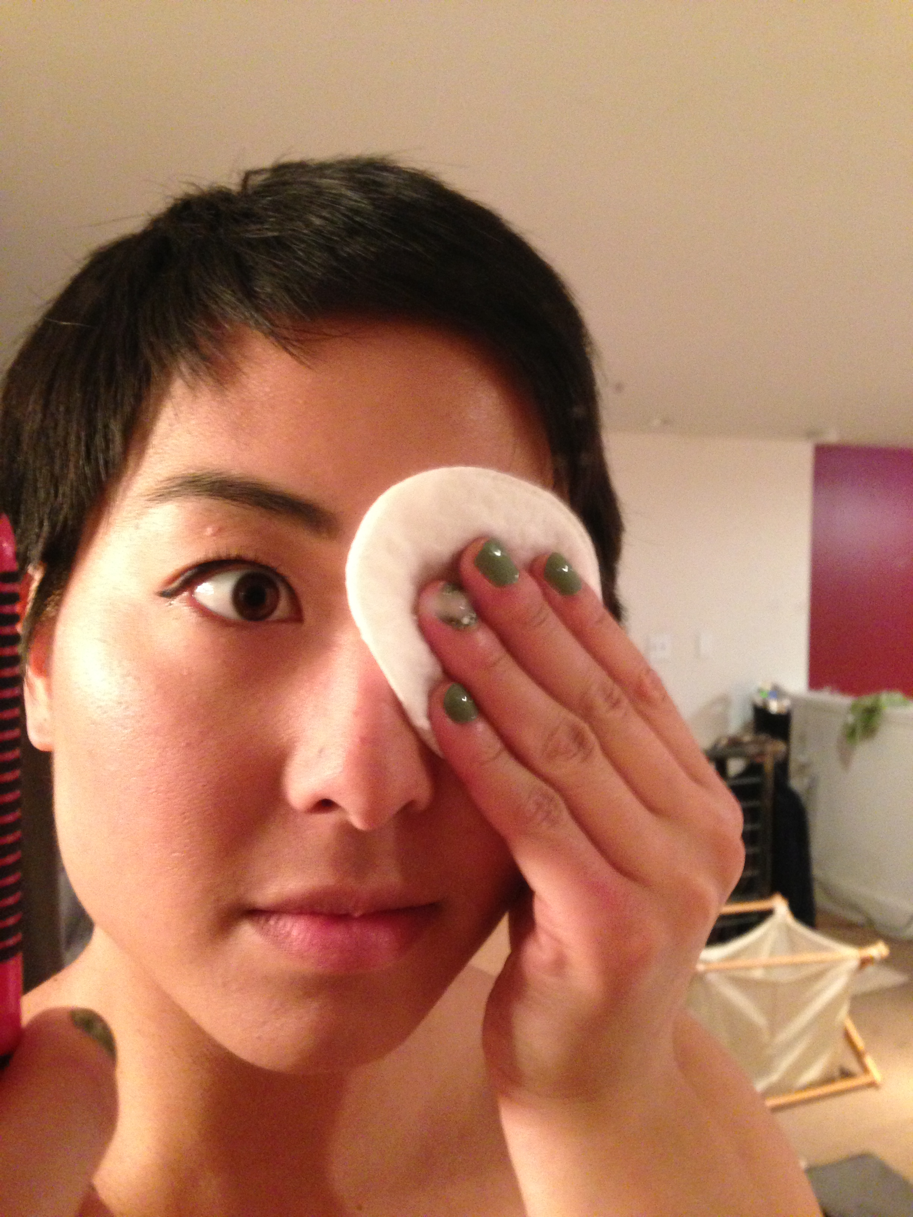
THE UNIVERSAL ROUTINE: “face” the day
MOISTURIZE
apply facial moisturizer
apply lotion to body
2. APPLY MAKEUP
apply cover up to dark spots and blemishes
apply foundation
apply powder
eyes (eye shadow, eyeliner, mascara, other eye treatments)
blush
lipstick or lip gloss and lip moisturizer
3. STYLE HAIR
starts with drying hair
apply products (gels, sprays, leave-in conditioner)
straighten or curl
blow dry/brush/iron
4. ODOR CONTROL
start with deodorant
cologne/perfume
appearances
8:00 PM
8:30 PM
9:15 PM
examples of products
NIVEA FOR MEN AFTERSHAVE
OLAY DAILY FACIAL MOISTURIZER
AVEENO POSITIVELY RADIANT DAILY MOISTURIZER
VARIATIONS
Some do not moisturize
More common in the winter
Some do not use facial moisturizer
xamples of products
M.A.C. FOUNDATION
CLINIQUE 8-HOUR EYE COLOUR
MAYBELLINE COLOR WHISPER LIP COLOR
NARS SOFT TOUCH SHADDOW PENCIL
COVER GIRL LASH BLAST
VARIATIONS
Some wear more than others
Some do more steps than others
Most men do not wear makeup
xamples of products
REDKIN SHEER STRAIGHT
TIGI BED HEAD
AMERICAN CREW POMADE
CONAIR CURLING WAND
CHI FLAT IRON
VARIATIONS
Most men don’t straighten or curl it
Some people don’t put gel or product in their hair
Some days people style their hair, on others they don’t
xamples of products
OLD SPICE PURE SPORT DEODORANT
SECRET OUTLAST DEODORANT
DEGREE ULTRA DRY
L’HOMME YVES ST. LAURENT COLOGNE
CURIOUS BY BRITNEY SPEARS
VARIATIONS
Some people don’t wear cologne or perfume

Slide 15
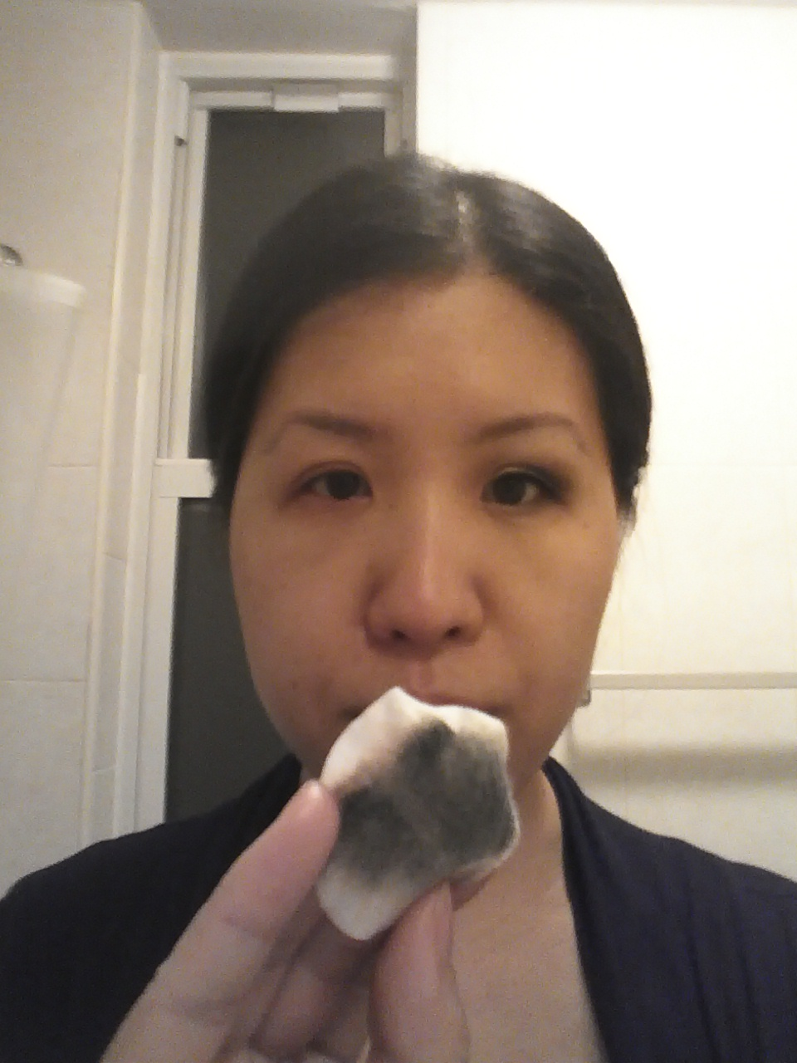
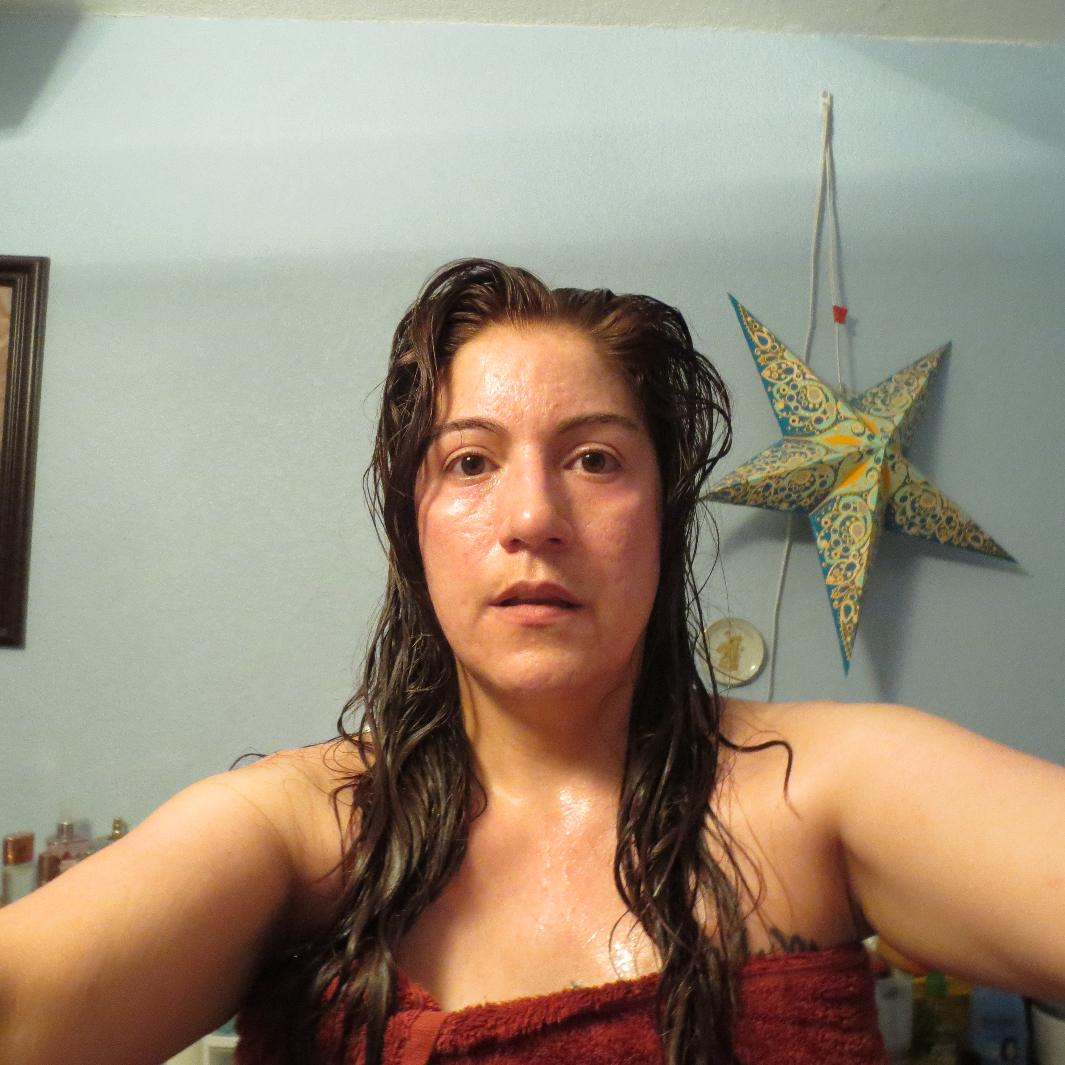
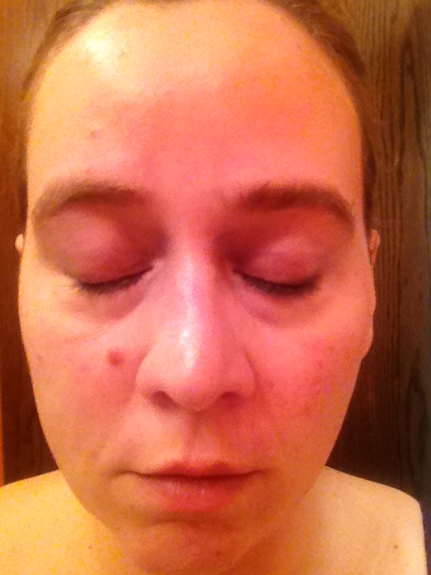
THE UNIVERSAL ROUTINE: REMOVE & RELAX
REMOVE MAKEUP
apply makeup remover with a clean pad
remove eye makeup
2. WASH FACE
rinse with warm water
scrub or exfoliate
apply cleanser
rinse with water
moisturize
nightime serums/anti-aging creams
3. SHOWER
cleanse body with soap or body wash
shampoo
conditioner
8:00 PM
Remove & Relax
8:30 PM
9:15 PM
Products
NEUTROGENA CLEANSING TOWELS
L’OREAL CLEAN ARTISTE
ALMAY EYE MAKEUP REMOVER PADS
VARIATIONS
some use petroleum based products or castor oil for eye makeup removal
some go straight to face wash for makeup removal
Products
CETAPHIL DAILY FACIAL CLEANSER
OXY MAXIMUM FACE WASH
NEUTROGENA DEEP CLEAN EXFOLIATING SCRUB
VARIATIONS
washing the face before bed induces relaxation and a sense of “taking off the day”
nightime face washing usually more thorough, includes exfoliating, masks, etc.
Products
NEXXUS HYDRA-LIGHT SHAMPOO
CETAPHIL GENTLE SKIN CLEANSER
TRESEMÈ HYDRATING CONDITIONER
OLD SPICE PURE SPORT BODY WASH
VARIATIONS
some wash hair in the morning
doubles as a morning time routine

Slide 16
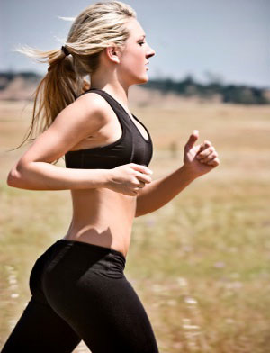
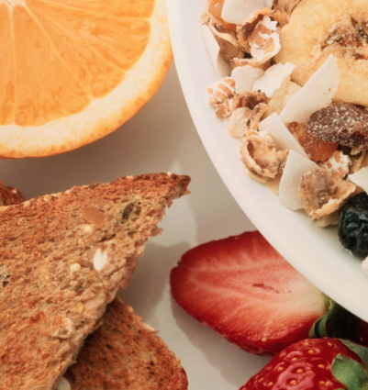
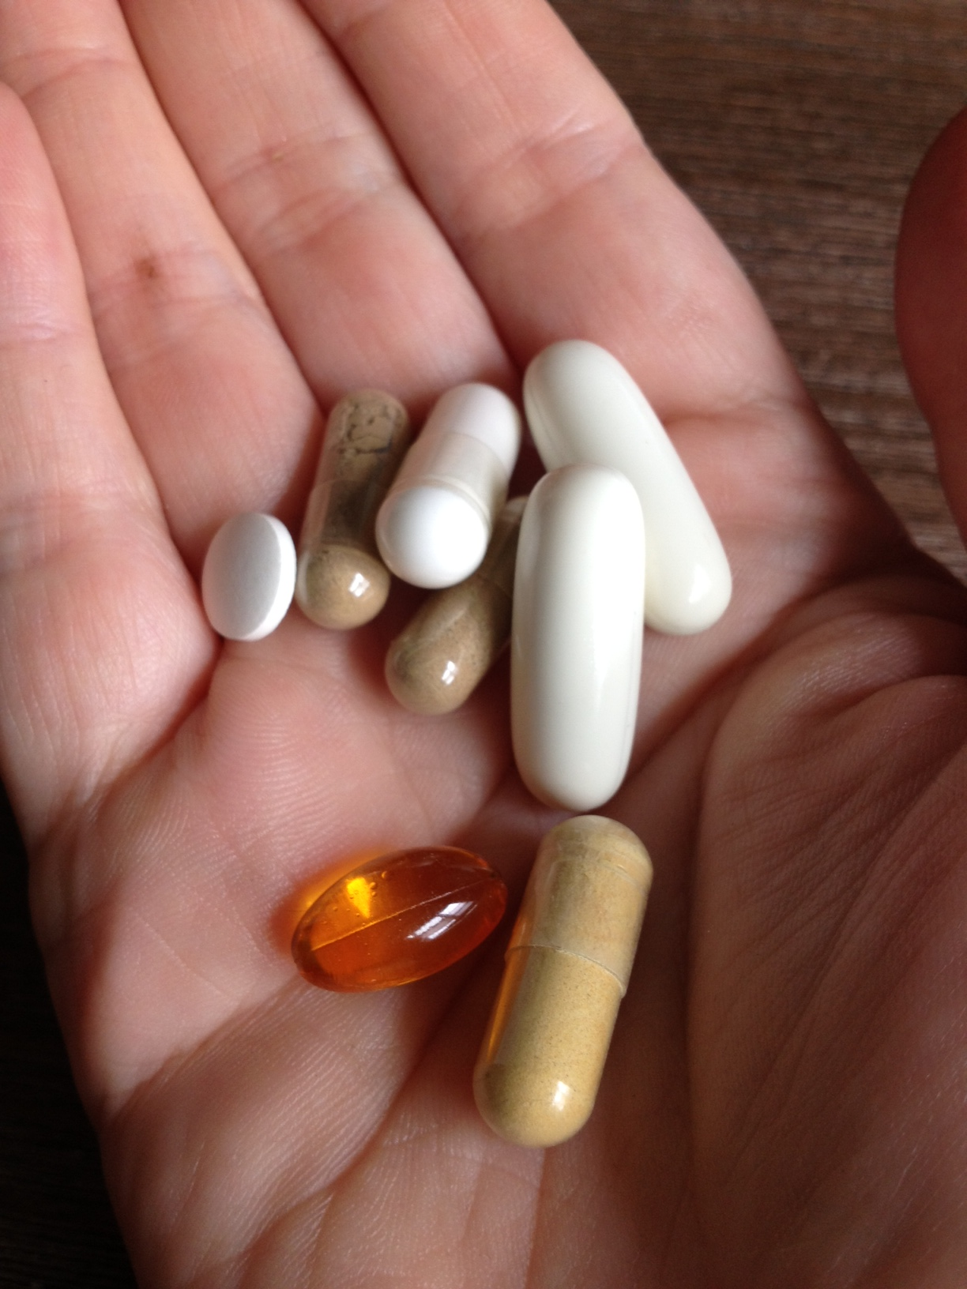
THE UNIVERSAL ROUTINE: INTERNAL HEALTH
EXERCISE
jogging
yoga
aerobics
waling
biking
2. SUPPLEMENTS
daily multivitamins
shakes with protein powder/other additives
3. OTHER MEASURES
Dieting
Eating organic
Internal Health
8:00 PM
8:30 PM
9:15 PM
examples of products
NIKE FREE RUNS
ADIDAS HYPER LIGHT
BOWFLEX TOTAL HOME GYM
VARIATIONS
high variation in frequency
some use at-home equipment
often seen as “me time”
believed to be a core part of health
examples of products
CENTRUM MULTIVITAMIN
ONE A DAY MENS MULTIVITAMIN
NOW VITAMINS FOR HAIR SKIN AND NAILS
VARIATIONS
Many people don’t take vitamins
examples of products
SLIM FAST MEAL SHAKES
WHOLE FOODS ORGANIC PRODUCE
KASHI GO LEAN CRUNCH

Slide 17
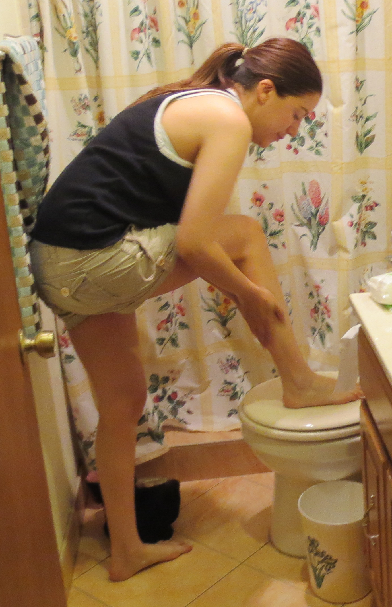
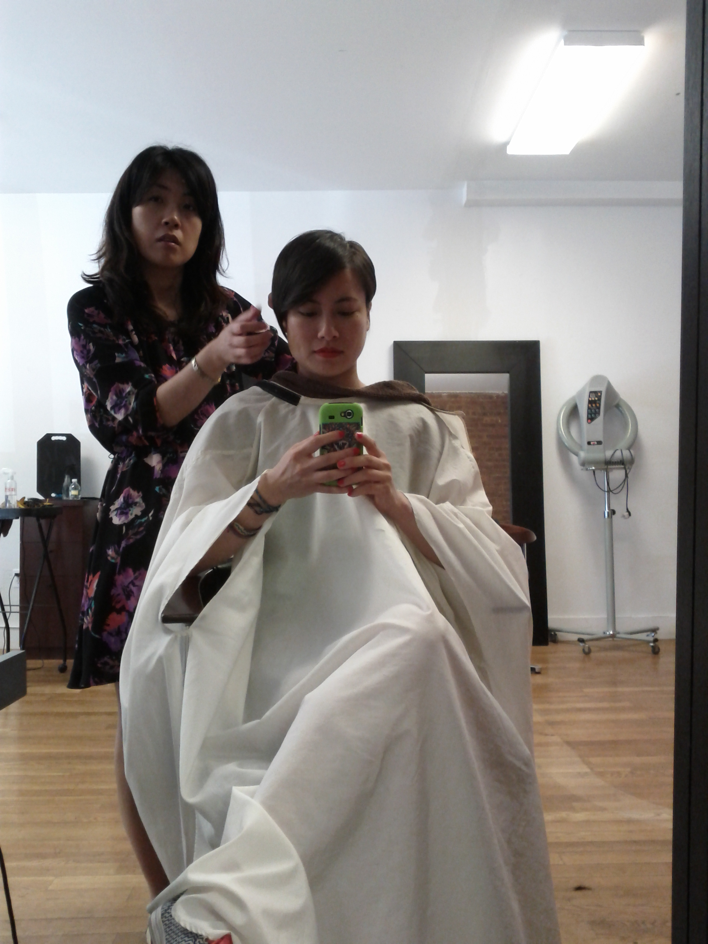
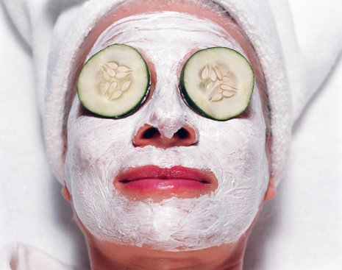
THE UNIVERSAL ROUTINE: special treat
SALON VISITS
2. FACIAL CARE
3. HAIR REMOVAL
occasional
8:00 PM
8:30 PM
9:15 PM
Products
REDKIN BODY FULL SHAMPOO
PAUL MITCHELL TEA TREE CONDITIONER
CHI
BIG SEXY HAIR
examples
ONCE A MONTH GET A HAIR CUT
ONCE EVERY TWO WEEKS GET NAILS DONE
ONCE A MONTH GET A MASSAGE
Products
CETAPHIL EXFOLIATING CLEANSER
NEUTROGENA CLEANSER MASK
Examples
DO A FACIAL MASK ONCE A WEEK
GO GET A FACIAL
other deep cleansing measures
Products
NAIR
LASER HAIR REMOVAL
NONO HOME HAIRL REMOVAL
FOLICA HAIR REMOVAL STRIPS
Examples
ONCE A WEEK TWEEZE
YOUR EYEBROWS
GO TO THE SALON AND
GET WAXED
ONCE EVERY TWO
MONTHS GET LASER
HAIR REMOVAL

Slide 18
consumer types

Slide 19
consumer types align with health, beauty and wellness
competitor: perfectionist when it comes to appearance
insecure: anxious about physical flaws
product junkie: highly concerned with beauty trends
B
time crunched: would focus
more on beauty if had more time
one & done: doesn’t want to waste too
much time on beauty
H
W
fitness nut: highly concerned
with health and fitness
holistic: seeks wellness over beauty
moderator: practical about daily challenges

Slide 20
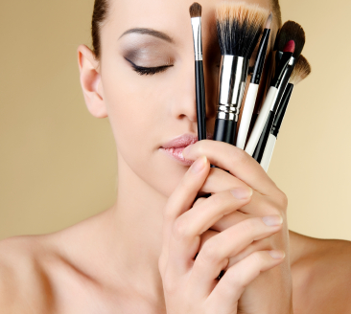
product junkie
highly concerned with appearance
passionate about beauty
insatiable appetite for new things
about me
I am addicted to products! I’m always looking online and in magazines for the latest trends and stay up late watching youtube tutorials! If I see something new, I just feel like I have to have it.
I’m always searching for the next big thing even though I like the products I’m using now. I’m just never satisfied!
about me
I’m looking for…
the latest trends, the newest products, the perfect solution to my beauty needs
refresh
B
“face” the day
✔
remove & relax
internal health
my concerns
I hate the idea that someone will have the newest products before me.
special treat
✔
entirely driven by beauty

Slide 21
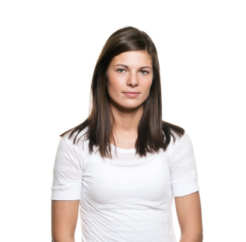
one & Done
practical
grounded
modest
about me
I care about how I look but I’d rather just be out the door and be done with it. anything that can make my routine go faster is good!
I prefer to sleep in on weekday mornings…I am NOT one of those women that spend hours on their hair in the morning!!
about me
I’m looking for…
time savers, ways to put less effort into looking good, good quality products that are easy to use
refresh
✔
W
“face” the day
B
remove & relax
✔
internal health
my concerns
I don’t want to waste too much time on my appearance but I still want to look good.
special treat
driven by wellness and beauty

Slide 22
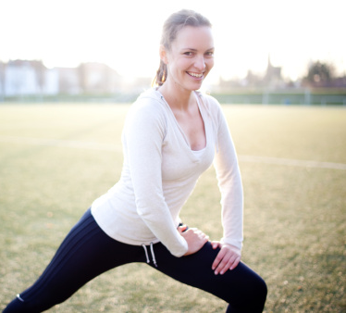
fitness nut
physically active
pro-active about my health
zealous about keeping fit
about me
being in good shape is really important to me. I work out almost every day, take daily vitamins, and drink shakes in the morning and night.
you have to think about the future…by being healthy NOW, you can help ensure that you will be healthier down the line
about me
I’m looking for…
I want assurance that I am safe from illness, and the security in knowing I’m doing everything I can to stay in good physical shape
refresh
“face” the day
remove & relax
H
internal health
✔
B
my concerns
im worried about getting older and more frail, and any disease or illnesses that I can’t control
special treat
mostly driven by health

Slide 23
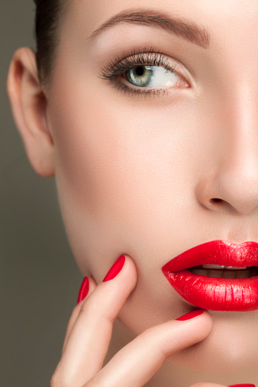
competitor
perfectionist when it comes to my appearance
detail-oriented
determined to look great
about me
I hate to admit it, but I can’t stand when others look better than me. I want to be the one who stands out.
most of my insecurities come from beauty related issues; I really can’t think of anything in regards to health or wellness
about me
I’m looking for…
attention, a chance to feel good about myself,
refresh
“face” the day
✔
B
remove & relax
internal health
my concerns
I hate to think t hat other people are better than me, and I am very concerned about my physical flaws
special treat
✔
entirely driven by beauty

Slide 24
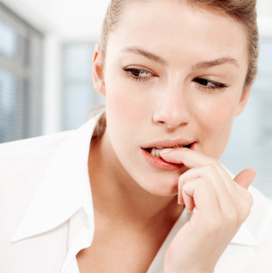
insecure
very self critical
just want to fit in
anxious that people will notice my flaws
about me
Im always thinking that people are staring at my imperfections. I never leave the house without makeup.
I wish I could feel I’m at my best when im natural, but im so self-conscious
about me
I’m looking for…
I want to fit in with everyone else, and be just as beautiful as the next person
refresh
✔
“face” the day
✔
B
remove & relax
✔
internal health
my concerns
the flaws in my appearance are my biggest concern, that and not fitting in
special treat
entirely driven by beauty

Slide 25
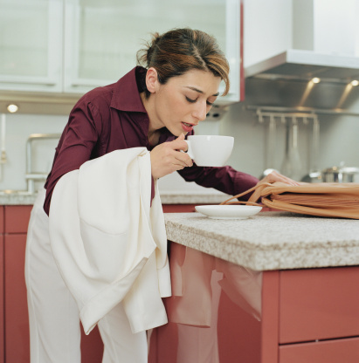
time crunched
overly active
overwhelmed by a busy schedule
wishful for some relaxation
about me
feels like I am always running around – working, taking care of the kids. I still want to look good but I don’t have enough time to put into a good routine
I am also always on the go during the week and end everyday feeling exhausted
about me
I’m looking for…
convenience! anything to make my day easier. id also love more “me time” so I can take better care of my health and beauty
refresh
✔
“face” the day
B
remove & relax
✔
H
internal health
my concerns
I worry about the stress in my life showing on my face and in my body.
special treat
driven by beauty, concerned with health

Slide 26
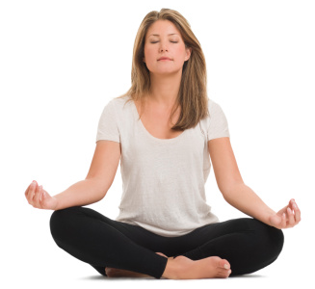
holistic
open-minded and experimental
interested in alternative solutions
curious and always seeking information
about me
I see beauty, ehalth and wellness as a whole. I want to look good, but I seek all sorts of ways of feeling good, like yoga, acupuncture, aromatherapy. I’ll try anything.
my definition of beauty embraces both the inner and outer…
about me
I’m looking for…
wellness and a sense of calm
refresh
“face” the day
W
remove & relax
internal health
my concerns
life is stressful enough. I want to keep myself well so I can enjoy all it has to offer.
special treat
✔
mostly driven by wellness

Slide 27
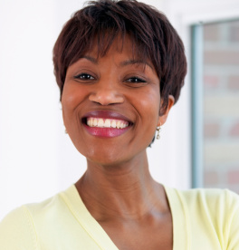
the moderator
easy-going and generally laid back
practical about daily challenges
seeking balance in work and life
about me
I care about being healthy but not so much that I don’t enjoy some fried food now and then. you can’t be “on” all the time!
I feel my absolute best when …I’ve had a well-rested sleep; have eaten well; had a productive day at work; gone out for a walk; and am out with my friends having good food, drinks and great conversation.
about me
refresh
✔
W
I’m looking for…
a stress-free life, even though I know you have to work for the things you want
“face” the day
remove & relax
H
internal health
✔
my concerns
I never want to lose my sense of being grounded and my ability to enjoy life
special treat
✔
driven by a healthy lifestyle

Slide 28
opportunities

Slide 29
opportunities
driven primarily by beauty
driven by beauty, health, wellness
eyebrow care
hair removal
grease control
lip gloss
hair growth
time and space in the shower
customizable cosmetics
thicker eyelashes
“Me” Time
health into beauty
all-in-one
daily luxury
on the go
prevention
socialize at home

Slide 30
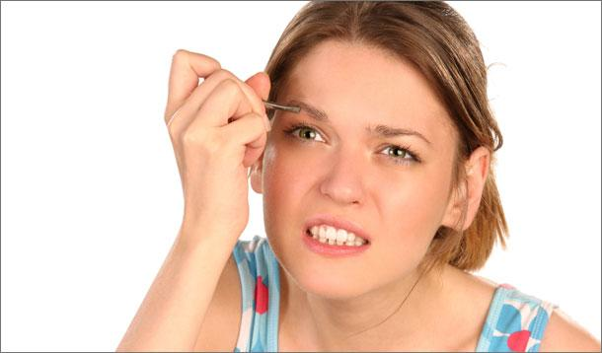
eyebrow care
Concept
quicker, cheaper eyebrow care at home
drivers
professional eyebrow care is tedious and time consuming
some consumers are plucking eyebrows daily
It would be nice to have something to remove the hair on my face when I don’t have time to go to the dermatologist to get it removed”
potential product ideas
At home laser hair removal device
At home gentle wax kit
refresh
“face” the day
✔
B
consumer type
one & done
time crunched
insecure
competitor
remove & relax
internal health
special treat

Slide 31
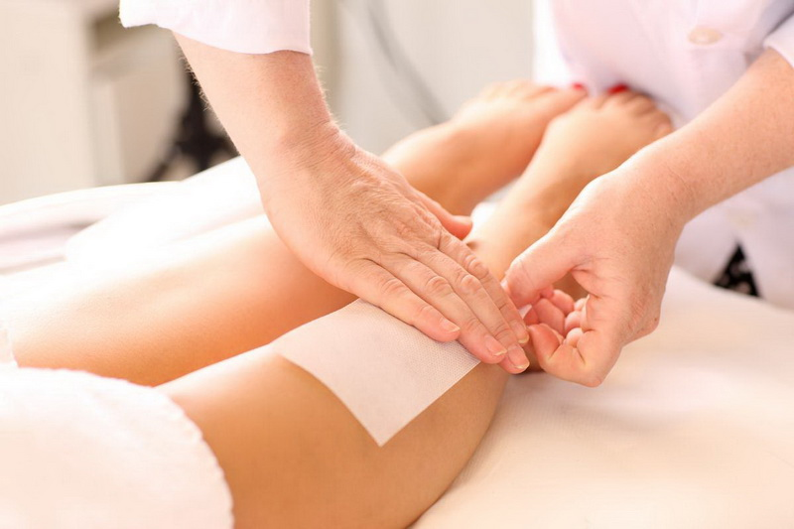
Hair removal
concept
quick, painless, cheap hair removal at home
drivers
lack of time to go to salon
certain hairs constantly grow and are never wanted
It would be nice to have something to remove the hair on my face when I don’t have time to go to the dermatologist to get it removed”
product ideas
At home laser hair removal device
At home gentle wax kit
consumer type
insecure
competitor
refresh
“face” the day
✔
B
remove & relax
internal health
special treat
✔

Slide 32
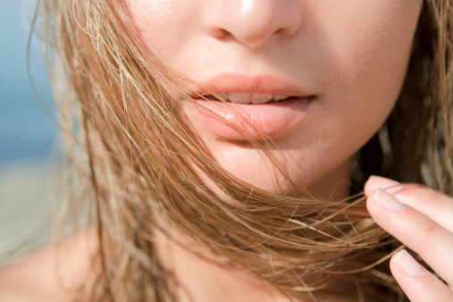
grease control
Concept
reduce time spent styling hair in the morning
concept ideas:
Non-oily or powdery dry shampoo
A head wrap that absorbs the hair oils while you sleep
drivers
lack of time in the morning to dry and style hair
I can’t tell you how many times I decide I don’t need to wash my hair the night before I wake up but then the next morning, my hair is much more oily than it was before I went to sleep
product ideas
head wrap that absorbs the hair oils while you sleep*
refresh
“face” the day
✔
B
consumer type
one and done
time crunched
remove & relax
internal health
special treat
*consumer’s product idea

Slide 33
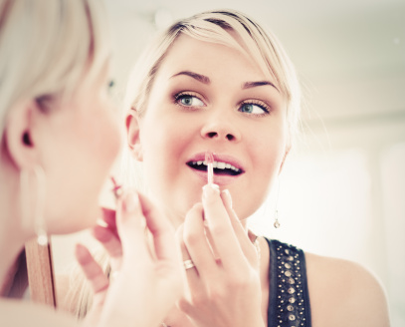
Lip gloss/Lip stick
concept
improve the texture and longevity of lip gloss
drivers
Women who do not like the feel of traditional lip glosses/lip sticks. They want a product that they will only have to apply once a day.
ANY brand of lipgloss that I have ever tried! I expect it to last more than ten minutes, which it rarely ever does… and the texture is always horrible
product ideas
one-a-day lip gloss
flavored lip gloss
lip gloss with a new texture
refresh
“face” the day
✔
B
remove & relax
consumer type
product junkie
competitor
internal health
special treat

Slide 34
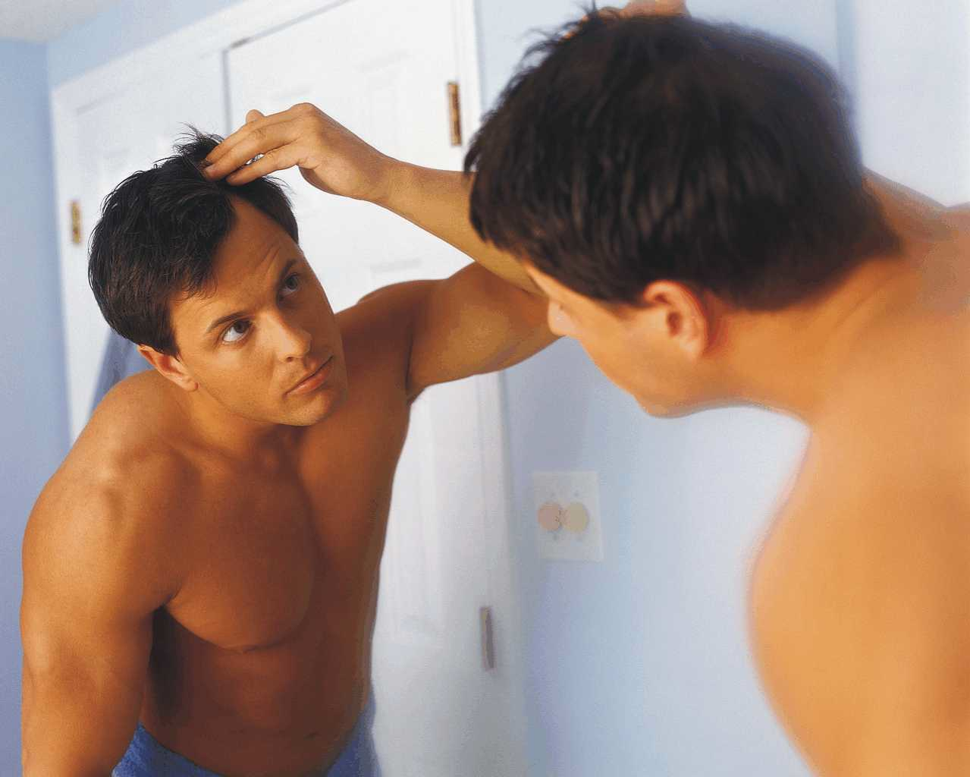
hair growth and styling gel
Concept
hair gel that also acts as a hair loss prevention product
drivers
fear of hair loss
active hair loss
“I bought shampoo, conditioner, deep cleanser, that claimed to result in fuller hair. It was an epic fail because it didn't work at all and costs over $100
product ideas
Hair gel with Rogaine qualities that combats hair loss.
A shampoo/conditioner that will combat against hair loss
styling gel that acts as conditioner and treats scalp for thinning*
refresh
“face” the day
✔v
B
consumer types
product junkie
insecure
remove & relax
internal health
special treat
*consumer’s concept

Slide 35
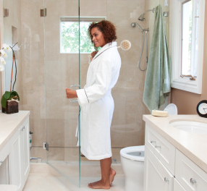
time and space in the shower
Concept
create more space in the shower, and save time showering
drivers
lack of space or clutter of products in the shower
lack of time in the morning
I have so many bottles in my shower that they’re just kind of everywhere
product ideas
shower head that has a soap dispenser cartridge in it
refresh
consumer type
time crunched
one and done
product junkie
moderator
“face” the day
B
remove & relax
✔
internal health
special treat

Slide 36
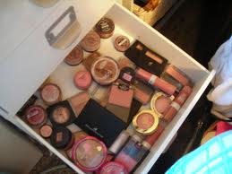
Customizable cosmetics (add nail color here)
concept
makeup that adjusts to skin type and combines several steps into one
drivers
skin that changes tones with the seasons
skin that changes throughout the day, from more oily to more dry
a faster makeup regimen
lack of space / prodcut clutter
I just don’t want to buy 3-4 different products if one can do the job for me”
product ideas
An all in one foundation or concealer
Make up that adjusts to your skin tone*
color mixer to mix your own foundation at home
color mixer for nail polish*
longer-lasting nail polish
refresh
“face” the day
✔
B
consumer types
product junkie
competitor
remove & relax
internal health
special treat
*consumer’s concept

Slide 37
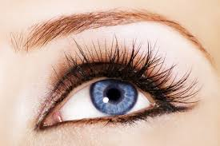
thicker eye lashes
concept
a thickening agent for eyelashes
drivers
concern over thinning eyelashes
trends that call for thick eyelashes
I got so used to long, thick, luxurious lashes in my youth and I am getting to that age where I notice their thinning “
product ideas
A lash thickening mascara
A vitamin that promotes last growth
A mascara or eye lash curler that promotes lash growth
refresh
“face” the day
B
consumer types
product junkie
competitor
✔
remove & relax
internal health
special treat

Slide 38
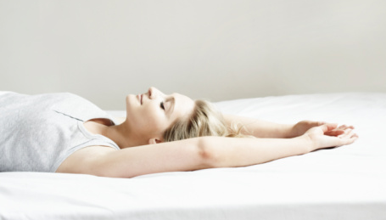
“me” time
Concept
moving closer to wellness by carving out more time to relax and be pampered
drivers
lack of time in busy schedules
a desire to stay looking fresh and beautiful, despite stress and lack of sleep
boredom with daily routines
when I take the time to beautify before going out into the world, I always feel better, more ready to interact with others, and more sure of myself
product \ ideas
timed facial masks or heated beauty treatments
product dispenser that plays relaxing audio soundtrack in the bathroom
warm beverages in the bathroom
foot warmers
warm wraps for hair, feet or face
refresh
“face” the day
consumer type
holistic
time crunched
moderator
remove & relax
✔
W
internal health
special treat
✔

Slide 39
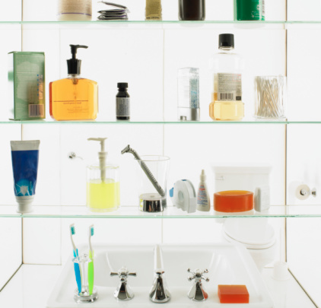
health into beauty
Concept
bring health into the bathroom
drivers
high awareness of health and its relationship to beauty
lack of opportunity to combine health and beauty in the morning routine
my health is my most valuable commodity.. I am hopeful that my preventative measures can keep me healthy for as long as possible
concept ideas
topical vitamins delivered in a lotion
makeup remover that helps eyelashes grow and improves skin health
liquid health “shot” in the bathroom that becomes part of routine
refresh
✔
“face” the day
✔
B
remove & relax
H
consumer type
fitness nut
holistic
time crunched
moderator
internal health
special treat

Slide 40
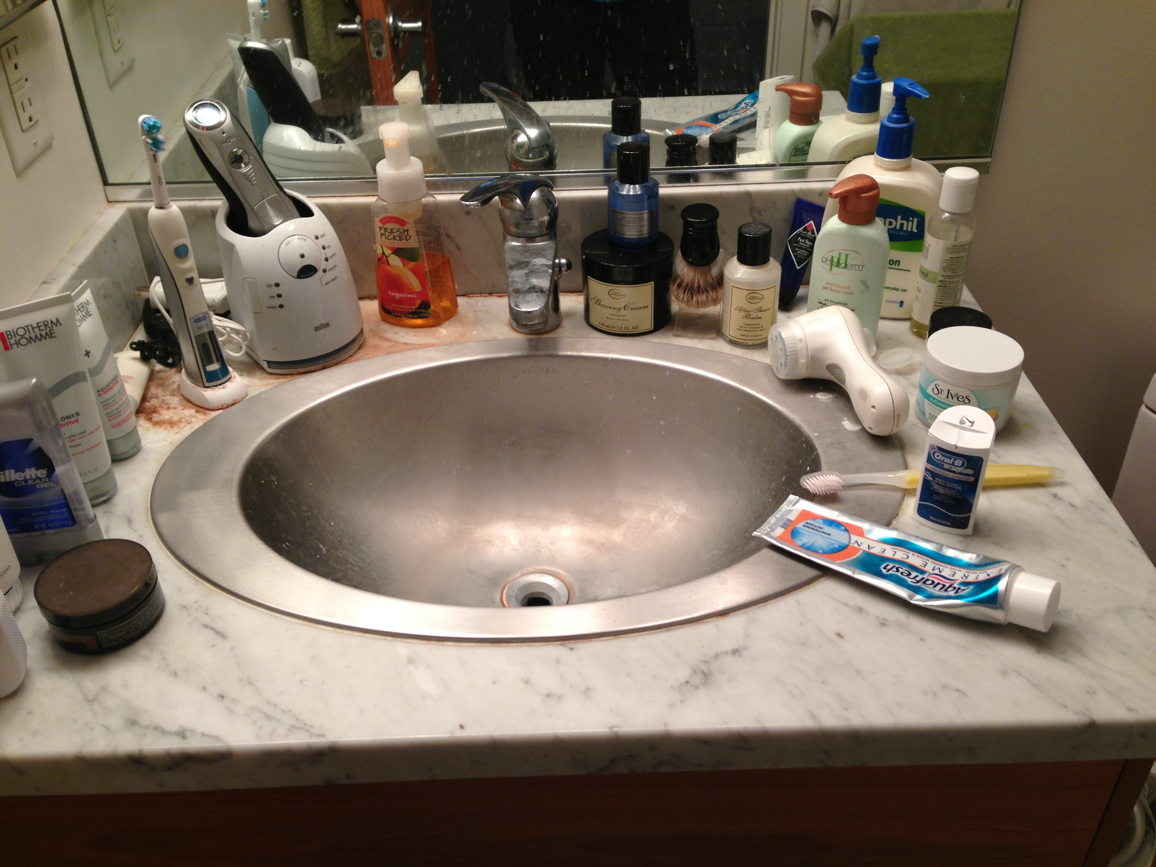
space savers
Concept
create more space in cluttered bathrooms
drivers
lack of space / clutter of products in the bathroom
there is definitely not enough space! I don’t even have a medicine cabinet Things still fall on the floor, or just get left out on the sink’s edge instead of going back into the baskets
product \ ideas
wireless hair dryer or other beauty appliance
wall-mounted product dispenser that consolidates several products
refresh
“face” the day
consumer type
product junkie
time crunched
remove & relax
✔
W
internal health
special treat

Slide 41
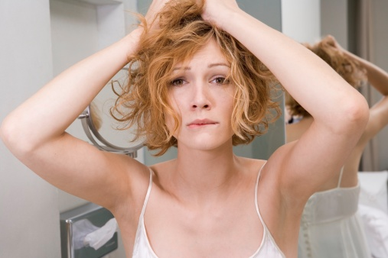
all-in-one
Concept
one product that saves space, time and money
drivers
bathrooms are cluttered
consumers wary of spending more on products they may not need
I would love to have a product that has multiple benefits
concept ideas
foundation that is also spf, moisturizer, toner
hair product that styles, conditions, washes and dries
refresh
✔
“face” the day
✔
B
consumer type
one and done
moderator
remove & relax
W
internal health
special treat

Slide 42
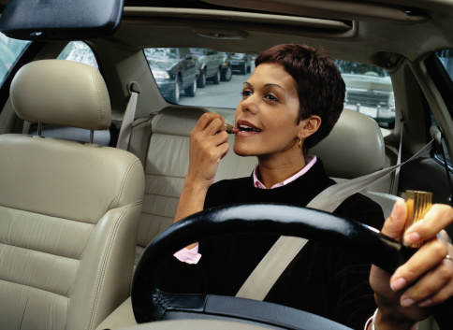
on the go
Concept
help speed up the morning routine by making part of it portable
drivers
busy schedules
too many steps in a beauty routine
If I find myself short on time I am known to put my hair up in a clip and just use the curling iron on bangs. I never do not do make-up but if I am traveling with my husband I have been know to apply make-up in the car.
concept ideas
portable pods with cosmetics or lotion
refresh
“face” the day
✔
B
consumer type
time crunched
one and done
moderator
remove & relax
W
internal health
special treat

Slide 43
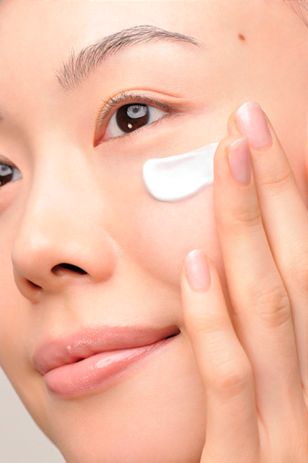
prevention
Concept
daily doses of prevention to ease peace of mind
drivers
fear of aging, illness and disease
fear of hair loss
I define Wellness as practices and routines that control or contribute to maximizing health. This includes, but is not limited to…engaging in preventative care
concept ideas
vitamin or SPF infused cosmetics
daily reminders or tips on preventative measures
beauty and health news delivered digitally in the bathroom
refresh
✔
“face” the day
consumer type
fitness nut
moderator
holistic
remove & relax
H
W
internal health
special treat

Slide 44
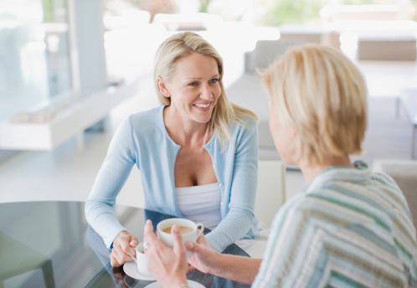
socialize at home
Concept
replicate the social aspect of salon experiences
drivers
interacting with others around common routines and desires
the pleasure of seeing friends at the salon
I feel very at home at the salon. I’ve been seeing my stylist for over a year so we’ve got a good routine going on. We talk about our personal lives, his new business and just general stuff about what’s happening in the city.
concept ideas
wall-mounted device that enables social networking in the bathroom or bedroom
direct consultation with beauty experts for a monthly fee
daily beauty advice
refresh
“face” the day
remove & relax
W
consumer type
holistic
moderator
internal health
special treat
✔

Slide 45
appendix

Slide 46
quotes on beauty
“Beauty to me refers to how great you look. It is something that attracts people to yourself.”
“Beauty would include all of the things you do to make yourself more attractive/sexy/desirable”
“…we should strive to present ourselves as best we can. In this day and age when everything is so competitive attempting to present yourself in a positive light is more important than ever.”
“I define beauty as the attributes of your appearance that are considered to be attractive”
“Beauty means taking care of my appearance”
“Beauty comes from taking care of yourself, makeup, hair, etc. Anything on the outside besides clothes”
“Beauty can be something you’re born with, but it’s also something that can enhance through better care of your body. If you take good care of yourself, you can potentially improve your level of beauty”
HOW SOCIETY TREATS YOU
“I always feel much better after getting myslef ‘put together’ – I feel that when I look my best that people talk to me differently, look me in the ye, etc. When I feel like I’m slumpy people treat me like I look slumpy”
CONFIDENCE:
“My definition of beauty is a confidence that you hold that you look good: this includes feeling good internally. My definition embraces both the inner and outer experiences”
“Beauty to me is all about confidence…Beauty is when everything comes together and is presented in a natural way.”
“To me, beauty is confidence. When I feel beautiful, I immediately feel more confident and powerful….beauty is something I have control over.”

Slide 47
beauty insights
how you look affects how you’re treated / society treats you differently based on beauty
most people want to fit in/hide flaws, rather than stand out for beauty
is beauty the ultimate driver? does beauty drive health and wellness?
inner vs outer beauty
confidence affects beauty
is beauty something you can improve/alter or are you born with it?
for most, beauty isn’t fun

Slide 48
quotes on wellness
“My most important belief is to approach beauty, health and wellness in a holistic and balanced manner because that is how I believe that true beauty and health in achieved”
“Wellness to me is a healthy mind and body connection. To me it is about keeping your mind and body in sync and feeing alive, healthy happy”
“Wellness is taking care of your body in ways that your body cannot do itself”
“a state of being in balance; being healthy in the physical body, mind and soul; a state of well being”
“wellness is more about your state of mind/well0being and maintaining a healthy balance in your life”
“wellness is a combination of health and beauty that determine your quality of life”
“A complete sense of well-being. You can do things like meditate, de-stress, relax…”
“I think it’s a mix of beauty and health. Wellness reflects on your inside and out.”
“Wellness is something that just comes together with everything else in your life. It is probably the hardest things to make come together, honestly.”
“Wellness combines physical and mental health as well as beauty, and defines the entirety of how you feel”
“Wellness is holistic”

Slide 49
health insights
general awareness that health is important and is tied to beauty
nothing healthy happens in the bathroom
health is about preventing the unknown, and a fear of it (disease)
health is maintained to prevent/slow aging (tied to beauty)
health is about working out, eating right, preventing illness
health more tied to wellness than beauty is tied to wellness

Slide 50
quotes on health
BEAUTY DRIVEN:
“You can look flawless on the outside but if you aren’t healthy you’re not beautiful”
“I want to look as good as I feel on the inside.”
“Health is freedom from pain, illness and physical barriers…”
“This is the physical and quantifiable condition your body is in…I believe that good health is at the core of true happiness”
“Health to me is treating your body as a temple. That includes exercise, eating right, and taking care of yourself to refrain from sickness and long term wear on your body.”
“The way my body feels. “
BEING ABLE BODIED
If I don’t have my health, I don’t have the ability to live happily and freely”
“I define health as being the current condition of your mind and body…this will determine your active abilities and if there are any hindrances or limitations.”
FEAR DRIVEN
“Sometimes being healthy kind of feels like waiting for the other shoe to drop…that it’s only a matter of time until it [illness] befalls me”
“I want to prevent diseases and illnesses…I try to eat healthy foods, wash my hands, avoid other sick people.”

Slide 51
wellness insights
perceived as combination of health and beauty
few talk about happiness/fun as wellness (approach is similar to work – focused, like an obligation)
salon visits fit here (for things that can’t be achieved at home ie: socializing, being treated)
wellness often seen as balance
wellness as treating yourself (“me time”, spa time, massages)
wellness as lack of stress
wellness is not part of daily routine, but rather something aspirational that one hopes for as a result of repeating routine daily

